Slide 1
HealthyFAT
Mobile Application UI Walkthrough

Slide 2

First screen when a new user opens the HealthyFAT application
HealthyFAT
Register
Already a member? Login Now

Slide 3
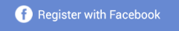


HealthyFAT
This screen will appear if the user clicks on ‘Register’.
------------------or------------------
junmingcjm@gmail.com
……
Register
By signing up, you are agreeing with HealthyFAT’s Terms and Service, and Privacy Policy

Slide 4
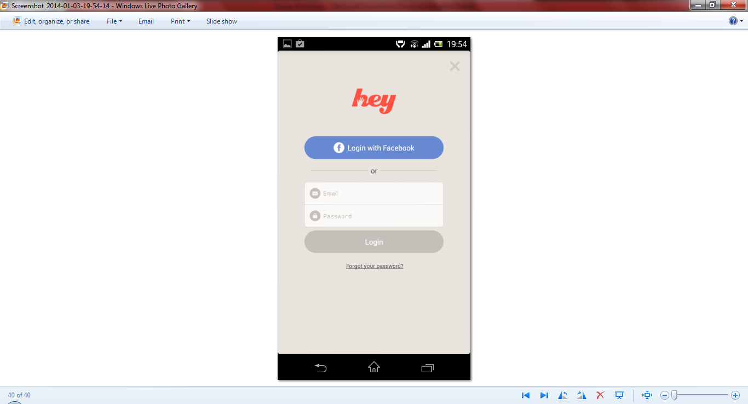
HealthyFAT
This screen will appear when the user clicks on ‘Login Now’.
-------------------or-----------------
junmingcjm@gmail.com
……
Login

Slide 5

HealthyFAT
This screen will appear after the user register for a new account. The user will be automatically logged in to the application.
Healthier Lifestyle…
Start by creating your very own profile!
Create Profile

Slide 6


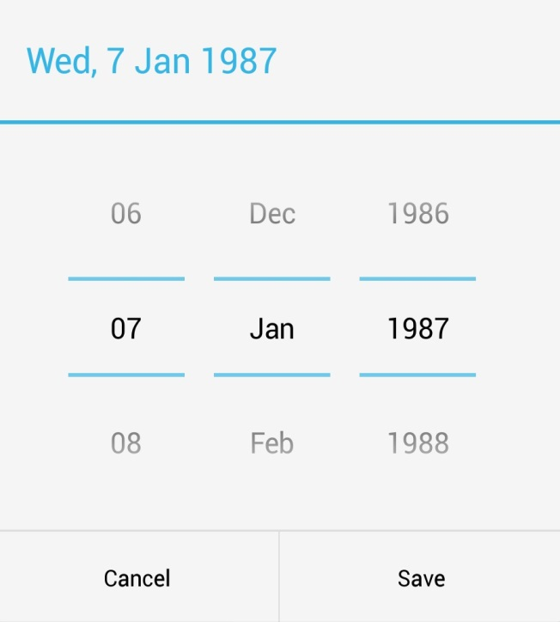

Date Selector: This will pop out when the user navigates the DOB section.
HealthyFAT
Basic Information
c
Nickname
JunMing
Date of Birth
28 01 1994
Gender
Male
Female

Slide 7

HealthyFAT
Photo
This will pop out when the user selects the ‘+’.
How about setting a
Profile Picture?
Choose From Facebook
Choose From Album
Skip this for now
Take A Photo

Slide 8



This is a summary / overview of the users daily calories intake.
HealthyFAT
Summary
Jan 06, Monday
RDA for Calories
3100 kcal
Calories Consumed
1860 kcal
New users will be able to see this summary page after creating the user profile, but there will not be any data available to be displayed
Calories Burned
0 kcal
60 % RDA
You are left with 40% of calories intake based on your RDA.

Slide 9
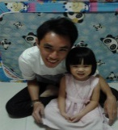








The user can have access to the navigation drawer by swiping to the right of the screen
JunMing junmingcjm@gmail.com
Summary
Home
The user can have access to the navigation drawer by tapping on the menu which will triggers the navigation menu.
Diet Tracker
Exercise Tracker
Weight Tracker
Informative
Social
Settings

Slide 10
Informative

Slide 11
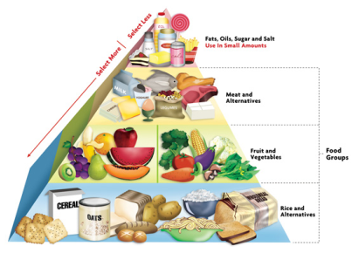
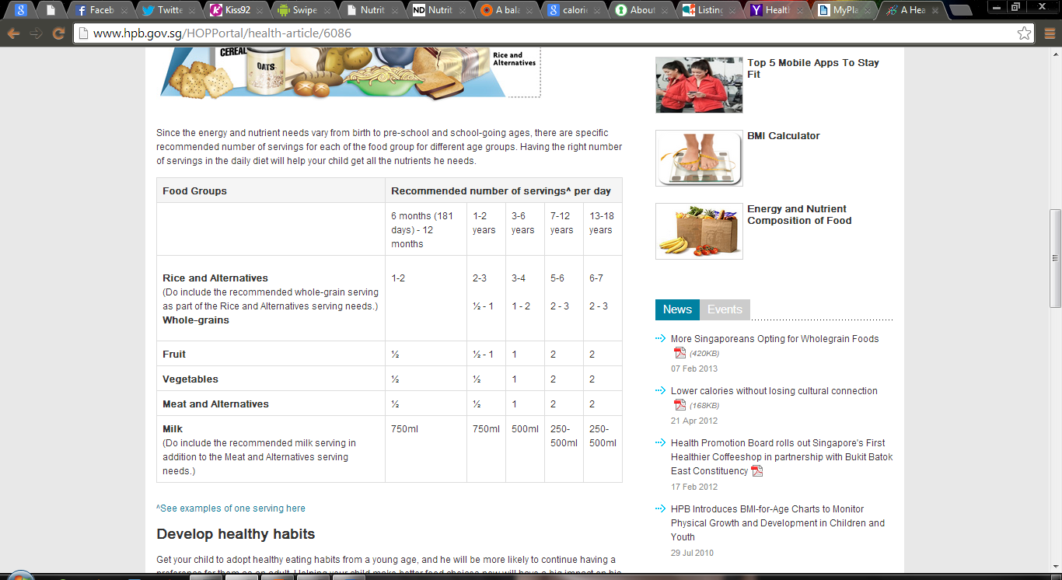
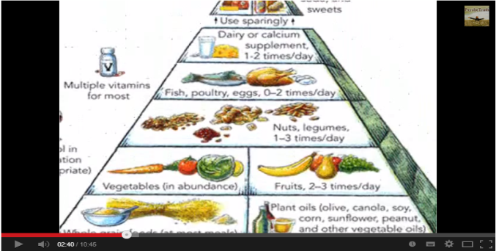
Provide read-ups, articles or even videos to educate the user.
HealthyFAT
Informative

Slide 12
Weight Tracker

Slide 13
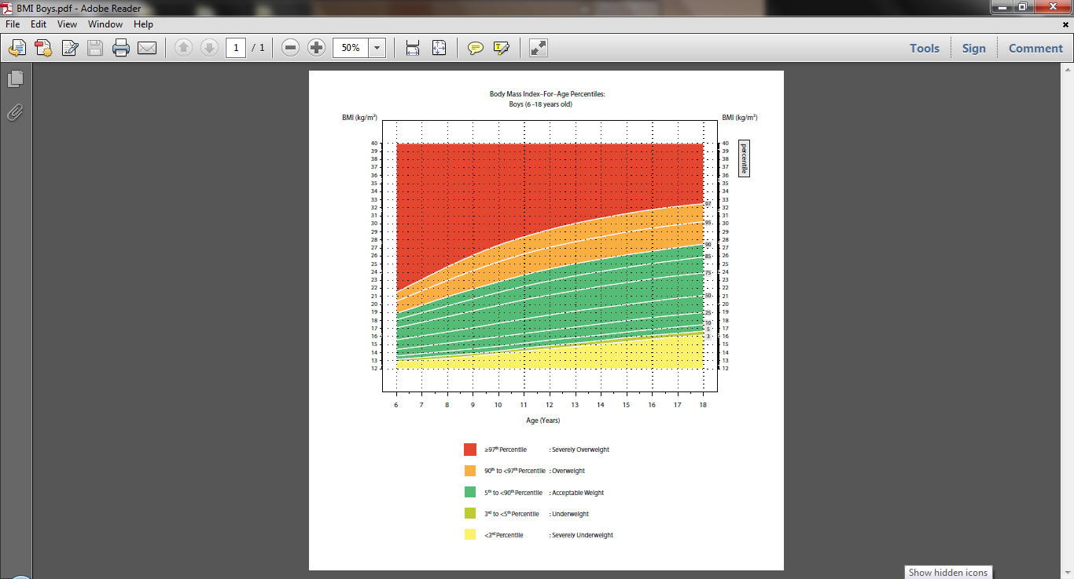
For Him
This user will be allow to calculate his/her BMI.
HealthyFAT
Weight Tracker
BMI
Weight Chart
Weight History
Calculate Your BMI
Weight 60 kg/lbs
Height 182 cm/m
Calculate

Slide 14
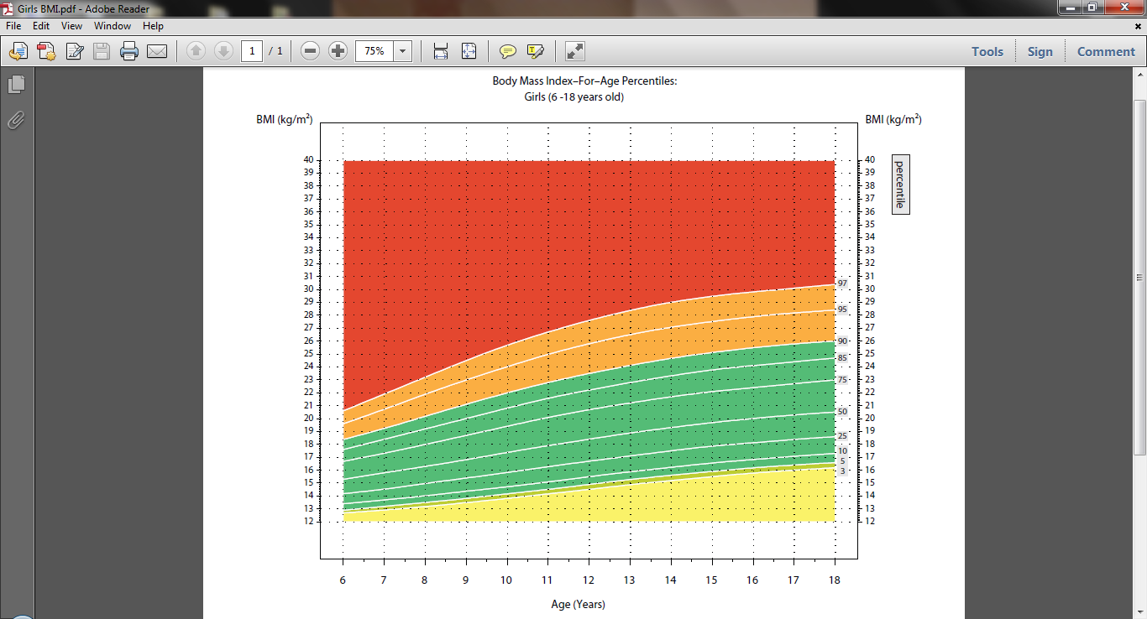
For Her
This user will be allow to calculate his/her BMI.
HealthyFAT
Weight Tracker
Weight Tracker
BMI
Weight Chart
Weight History
Calculate Your BMI
Weight kg/lbs
Height cm/m
Calculate

Slide 15
HealthyFAT
Weight Tracker
BMI
Weight Chart
Weight History
BMI Value 18.1
Congratulations! You have a very healthy BMI value!
Keep up the good work to maintain your weight with adequate amount of exercise and eat healthily.
This serve as a motivation or encouragement to the user
The BMI-for-age percentile chart will show the user their BMI based on their height, weight, gender and age.

Slide 16
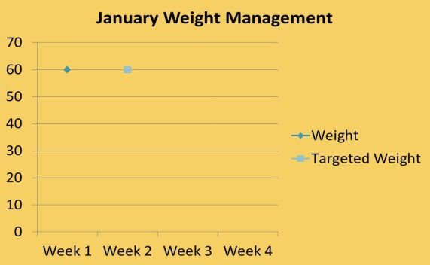
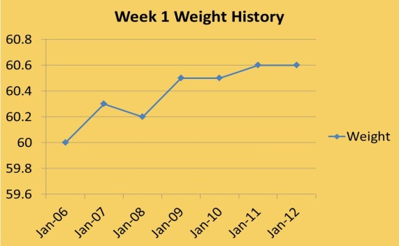


The user’s weight management progress can view in the form of charts for easy viewing.
HealthyFAT
Weight Tracker
BMI
Weight Chart
Weight History
The user will be able to set his/her target weight by selecting ‘Set Weight Goal’.
Enter Weight
59
60
kg
Set Current Weight
Set Weight Goal
61

Slide 17
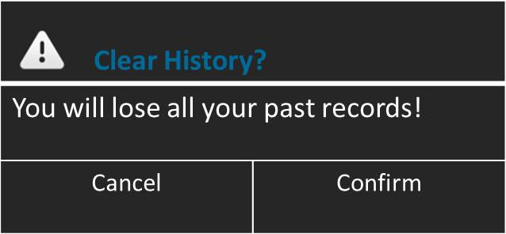
This page will show the overview of the user’s weekly weight management progress.
HealthyFAT
Weight Tracker
BMI
Weight Chart
Weight History
Date | Weight (kg) | +/-
Jan 06 | 60 | 0
Jan 07 | 60.3 | +0.3
Jan 08 | 60.2 | -0.1
Jan 09 | 60.5 | +0.3
Jan 10 | 60.5 | 0
Jan 11 | 60.6 | +0.1
Jan 12 | 60.6 | 0
The user can clear the history of his/her weight management records. Upon selecting ‘Clear History’, a warning message will pop out to warn the user that all records will be deleted upon confirmation.
. . .
Clear History

Slide 18
Diet Tracker

Slide 19
The user will have a look at his/her calories intake before adding a meal.
HealthyFAT
Diet Tracker
The user can select ‘Calories Consumed’ or ‘Calories Burned’ to see their daily diet and exercise tracker.
Jan 06, Monday
Keep track of your daily diet!
RDA for Calories
3100 kcal
The user can then start adding a meal by selecting ‘Add a Meal (+)’.
Calories Consumed
1860 kcal
Calories Burned
3100 kcal
60 % RDA
Add a Meal (+)

Slide 20
HealthyFAT
When the user selects ‘Breakfast’ … …
Diet Tracker
Jan 06, Monday
Breakfast
Lunch
A minimum of 5 meals available which caters to the users needs.
Tea Break
Dinner
Supper

Slide 21
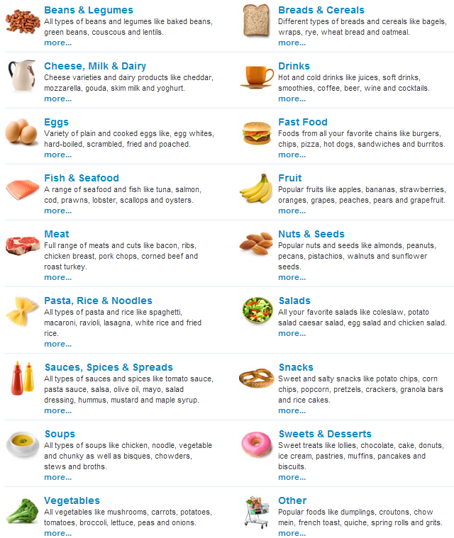
HealthyFAT
HealthyFAT
Diet Tracker
Diet Tracker
Jan 06, Monday
Jan 06, Monday
List of Bread & Cereals options to choose from

Slide 22
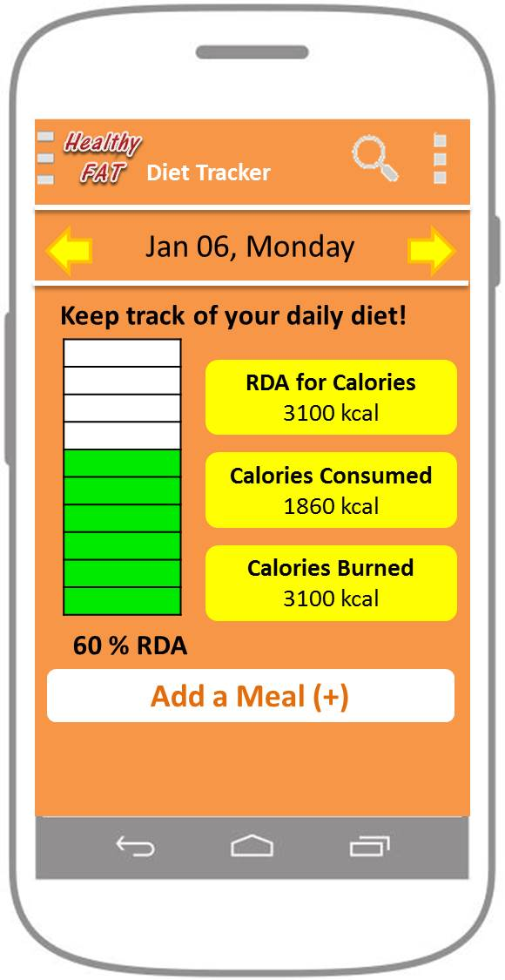
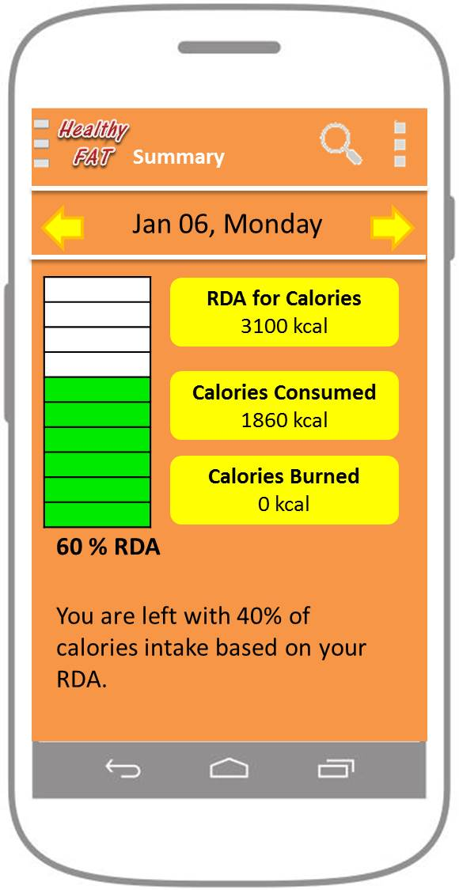
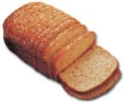
HealthyFAT
Diet Tracker
Jan 06, Monday
Serving Size
2 Slices
Wholemeal Bread
Quantity
Nutritional Value
Calories
Fats
Carbohydrates
Protein
Dietary Fiber
Vitamins
The values on the Summary page and Diet Tracker page will change respectively after adding a meal.
Save to Diet Diary

Slide 23
HealthyFAT
User can see his/her Recommended Daily Allowances in the form of reports (daily/weekly).
Diet Tracker
Jan 06, Monday
Keep track of your daily diet!
RDA for Calories
3100 kcal
User can see his/her daily meals breakdown by selecting ‘Calories Consumed’.
Calories Consumed
1860 kcal
Calories Burned
3100 kcal
60 % RDA
Add a Meal (+)

Slide 24
The list of food consumed will be shown when the user select the various categories.
HealthyFAT
Diet Tracker
Jan 06, Monday
→Breakfast
This link will guide and teach the user on how to improve their daily diet to obtain higher grade.
List of food consumed by the user
The grading that the user obtained is based on his/her diet with reference to the Healthy Plate and the Recommended Daily Allowances
→Lunch
→ Tea Break
→ Dinner
→ Supper
Daily Grade B
Here’s how you can obtain a better grading!

Slide 25
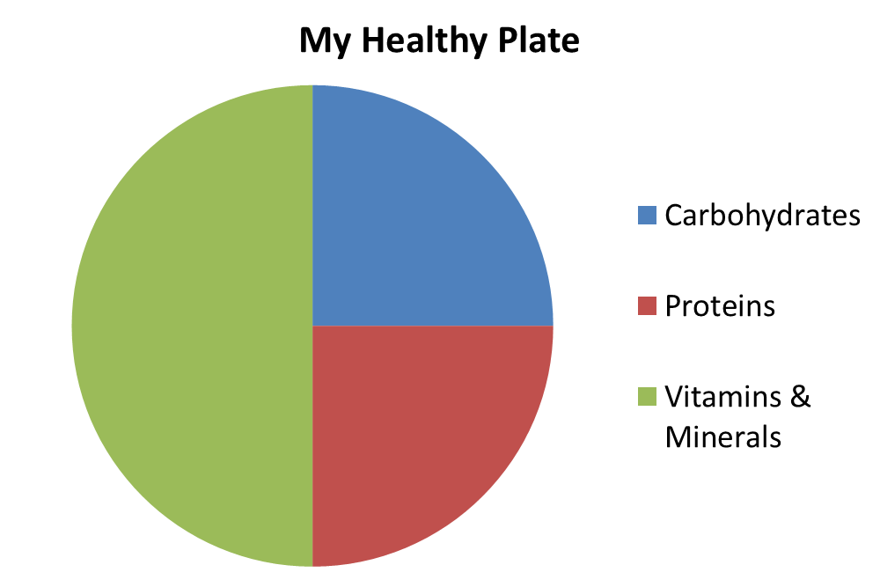
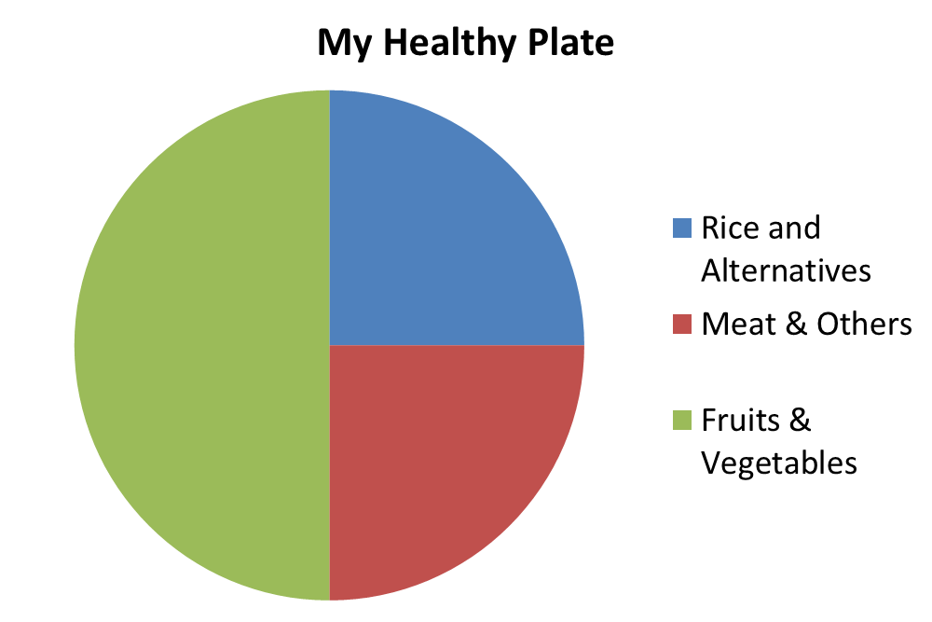
Provide the users with explanation on the importance of having a wide variety of food rather than super-sized portions just on one of the food categories.
HealthyFAT
Diet Tracker

Slide 26
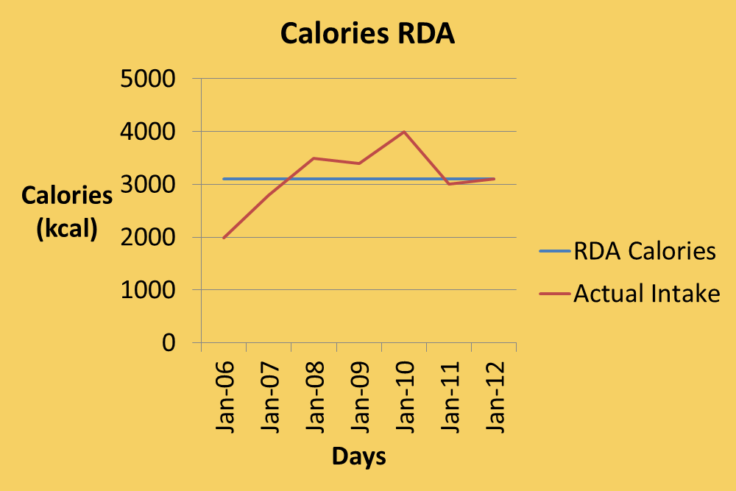
This is the Recommended Daily Allowances for various categories of nutrients. The user can swipe from right to left to access the various reports.
HealthyFAT
HealthyFAT
Diet Tracker
Diet Tracker
Date | RDA Calories (kcal) | Actual Intake
Jan 06 | 3100 | 1992
Jan 07 | 3100 | 2800
Jan 08 | 3100 | 3500
Jan 09 | 3100 | 3400
Jan 10 | 3100 | 4000
Jan 11 | 3100 | 3000
Jan 12 | 3100 | 3100
Average |  | 3113.10
. . . . . .
. . . . . .

Slide 27
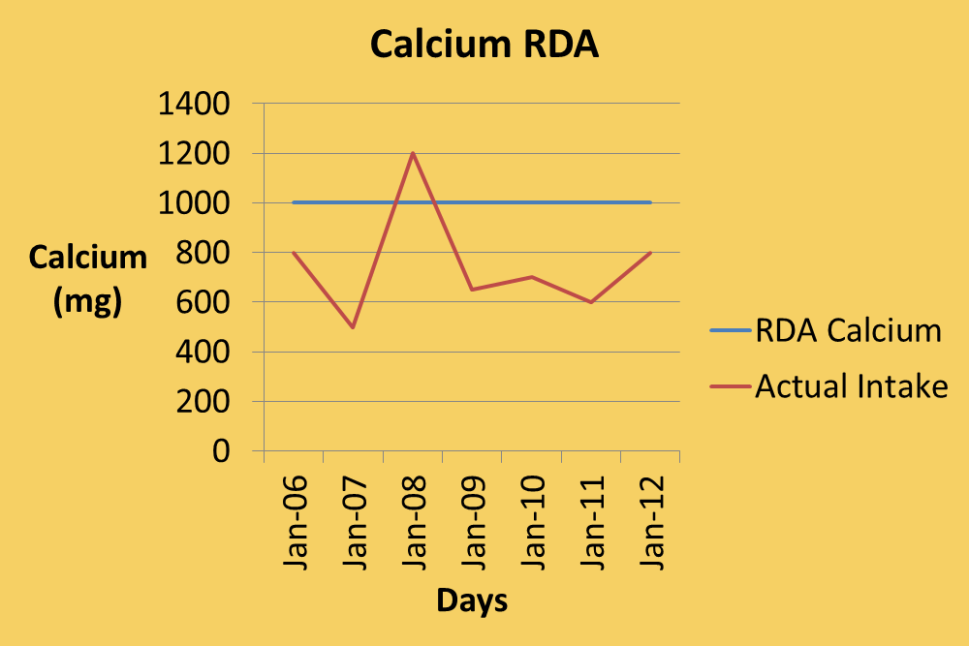
HealthyFAT
HealthyFAT
Diet Tracker
Diet Tracker
Date | RDA Calcium (mg) | Actual Intake
Jan 06 | 1000 | 800
Jan 07 | 1000 | 500
Jan 08 | 1000 | 1200
Jan 09 | 1000 | 650
Jan 10 | 1000 | 700
Jan 11 | 1000 | 600
Jan 12 | 1000 | 800
Average |  | 750
This serves as a indicator to the user that he/she might be lacking/having excess of certain nutrients.
Your calcium intake is insufficient for your age group. This puts you in a great risk of getting osteoporosis. You are recommended to consume more of this food: Milk, Sardines, Leafy Green Vegetables.
Food to cut down: Coffee
. . . . . .
. . . . . .

Slide 28
Exercise Tracker

Slide 29




HealthyFAT
Exercise Tracker
The user can calculate his/her calories burned with the help of the GPS while exercising.
During Exercise
After Exercise
Calories
0 kcal
Duration
0:00:00
Other Data
Other Data
Football

Slide 30
HealthyFAT
Exercise Tracker
The user can calculate his/her calories burned with the help of the GPS while exercising.
Calories
0 kcal
Duration
0:00:00
Other Data
Other Data
Football

Slide 31
HealthyFAT
HealthyFAT
Exercise Tracker
Exercise Tracker
Jan 06, Monday
The next screen will appear when user selects ‘Add Exercise’.
User can then add exercises according to his/her preferences.
The exercises will then be added and shown on the first screen.
Jan 06, Monday
Estimated Calories
0 kcal
Sport
Duration
Distance
Save
Add Exercise
View Progress

Slide 32
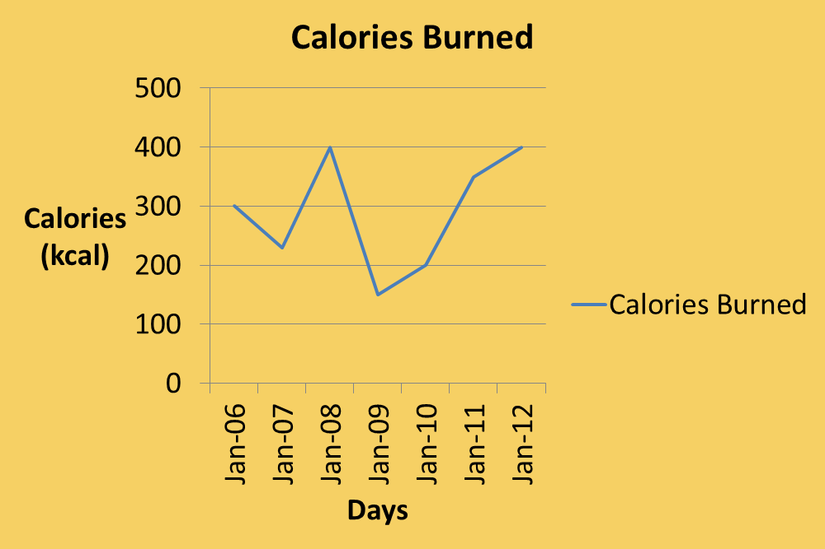
This is the daily/weekly report for the exercise tracker. The user can swipe from right to left to access the various reports.
HealthyFAT
HealthyFAT
Exercise Tracker
Exercise Tracker
Date | Calories Burned (kcal)
Jan 06 | 300
Jan 07 | 230
Jan 08 | 400
Jan 09 | 150
Jan 10 | 200
Jan 11 | 350
Jan 12 | 400
. .
. .

Slide 33
Social
(Friends System)

Slide 34



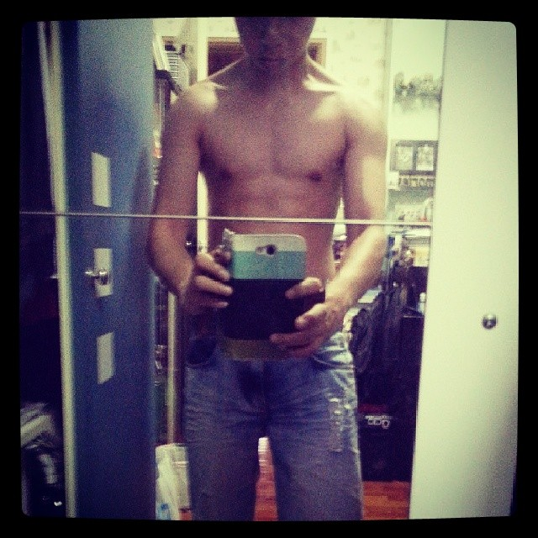


This screen shows the friend’s feeds, to see what are your peers health and fitness progress.
HealthyFAT
HealthyFAT
Social
Social
News Feed
Challenges
News Feed
Challenges
WeiXiang just ran 2.4 kilometers in 9 minutes! Do you think you can do better? Challenge WeiXiang! 13:15
WeiXiang challenged you to in a 2.4 kilometers run? Are you up for it?
Accept
Reject
YiHan just did 20 pull ups at one go! Do you think you can do better? Challenge YiHan! 13:00
Philbert challenged you to lose 1 kg in in weeks time. Are you up for it?
Philbert has uploaded a photo: “Great workout I’ve just had! 12:10
Accept
Reject
The user can accept challenges from their friends and the user can also challenge their friends with various health activities
People You May Know:

